Slide 1
Digital Asset Custody Service
Haechan Lee
Nguyen, Van Tu
Minji Choi
Jeongheon Kim

Slide 2

Introduction - DACS
Digital Asset Custody Service (DACS)
Keep users private digital asset (Cryptocurrency, NFT) safely
The Ownership of digital assets can be proved by only the owner’s private key
DACS 1. Digital Asset Consignment
management Service
Multi-Party Computation
(MPC)
DACS 2. Private Key management service
Multi Signatures
(Multi-Sig)

Slide 3

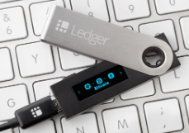

Introduction - Wallets
Hot Wallet
✓ Connected to the Internet
✓ Easy access to your funds
✓ User friendly, more services
✘ Vulnerable to cyberthreats
Cold Wallet
✘ Not connected to the Internet
✘ Funds are difficult to access
✘ Only storage, no extra services
✓ Impossible to hack, but can be lost
Warm Wallet
✓ Connected to the Internet
✓ Quick, global access to funds
✓ Wide range of services enabled
✓ Keeps crypto in cold storage
$
$
$
$
$
$
$
$
$

Slide 4


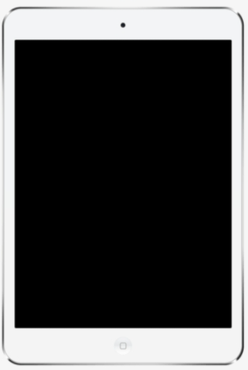
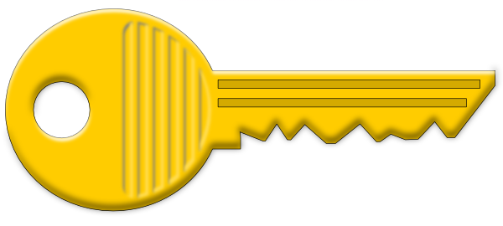


Digital Asset Security
Single-Key Signatures
Multi Signatures
MPC
Approver
Approver
Approver
Approver
Approver
Approver
Approver
Wallet
Ledger
Ledger
Ledger
A key is stored on a single storage device
Provides security based on hardware equipment or cold storage
Limited flexibility
More than required number of approvers sign is needed.
Customized development for each ledger
Fee setting ∝ processing time
Excellent security, flexibility and fast processing speed
Encryption algorithm applied
Policy-Based Distributed Validation
Easy to change approvers

Slide 5
Digital Asset Security - Comparison
 | Single Signatures | Multi Signatures | MPC
Security | O | OO | OOO
Privacy | X | X | O
Scalability | O | X | O
Transaction Size / Efficiency | O | X | O
Static Account Address Support | X | X | O

Slide 6
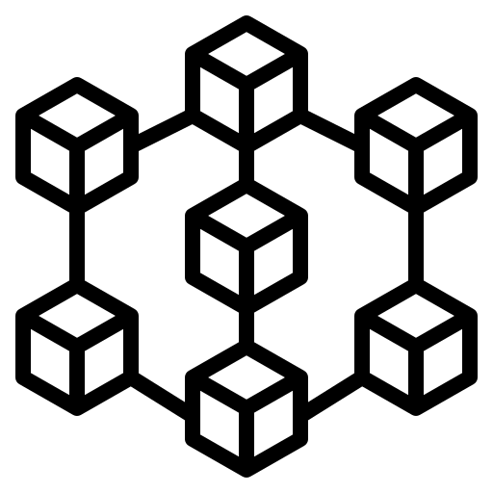
Architecture Design
Customer
Customer
Customer
Customer
Customer
Layer 0
User Wallet – Web (Front-End)
Layer 1
API
API
API
API
API
Multi-sig Smart Contract
Intermediary Server (Back-End)
Layer 2
User Backup Key Storage
Key Storage
Key Storage
Key Storage
Cold Wallet
Cold Wallet
Cold Wallet
Blockchain Node
Cold Wallet for Multi-sig
Layer 3
MPC-based Key Management System
MPC-based Key Management System
MPC-based Key Management System
Service Provider

Slide 7




High-level Workflow – Key management (Send transaction)
1. Request to send transaction using keys
2. Send request using API
2-a. Request backup key if one of user’s key is lost
3. Call the multi-sig smart contract
4. Confirm transaction
5. Check transaction history
Customer
Wallet
Server
Blockchain
Backup Key Storage

Slide 8
High-level Workflow – Consignment management (Found asset)
1. Request to found the consigned asset
2. Send request using API
3. Request signature
4. Create signature using MPC
5. Send created signature
6. Send signed transaction
7. Confirm transaction
8. Check balance
Customer
Wallet
Server
Blockchain
Key Storage

Slide 9
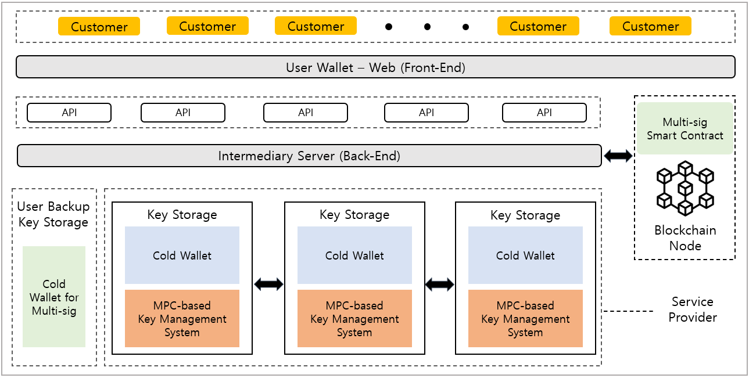



Implementation Overview
User interface
2-of-3 multi-sig (Open Source) (https://github.com/BitGo/eth-multisig-v4)
Ethereum private network
Node.js for API server
Geth (Go-Ethereum) for Ethereum client
(https://github.com/ethereum/go-Ethereum)
Server
Multi-party ECDSA protocol (Open Source)
GG18 (ECDSA Threshold)¹
[1] Gennaro, R., Goldfeder, S.: Fast multiparty threshold ecdsa with fast trustless setup. In: Proceedings of the 2018 ACM SIGSAC Conference on Computer and Communications Security. pp. 1179–1194. ACM (2018)

Slide 10
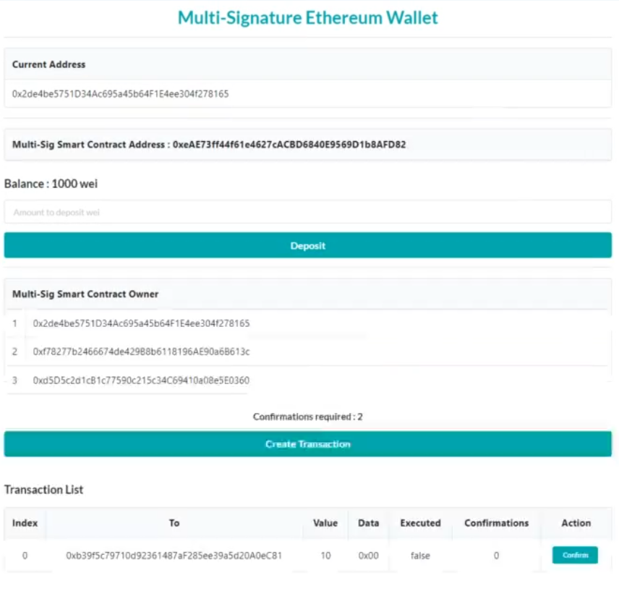
Implementation Details
User Dashboard (front-end)
Dashboard for the user
Show the wallets that own the multisig smart contract
Deposit to contract address
Create transaction
Show the transaction list and allow owners to confirm

Slide 11
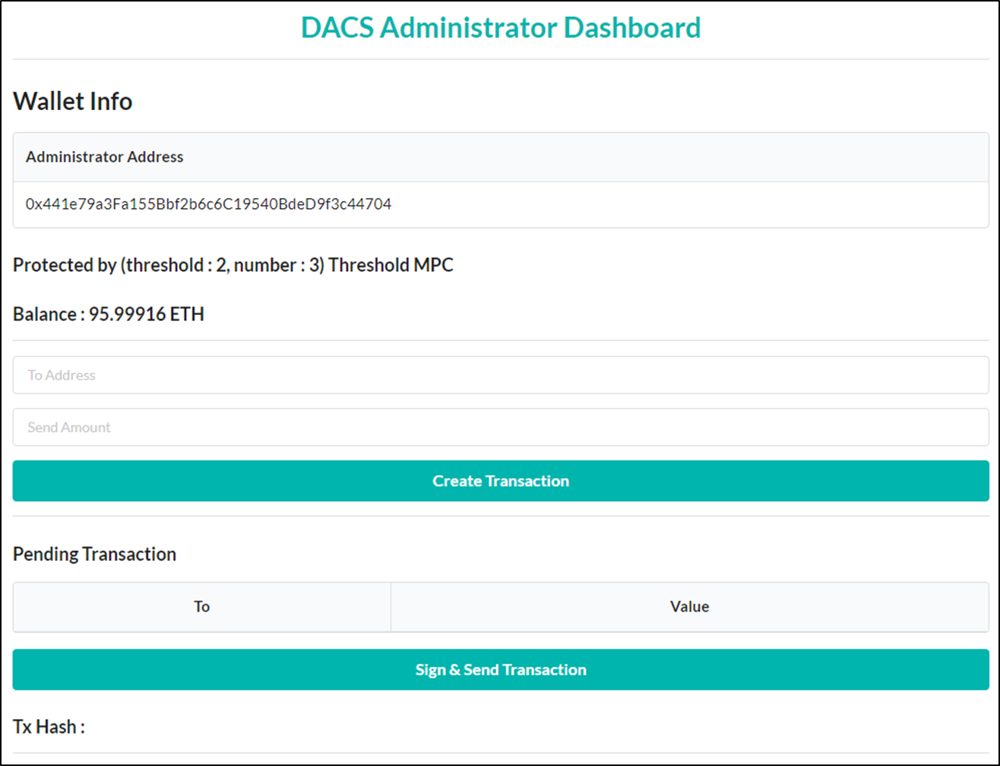
Implementation Details
Administrator Dashboard (front-end)
Dashboard for the DACS service provider (administrator)
Show the wallet info
Address
Balance
Current MPC policy (t-of-n)
Create & show Unsigned Transaction
Sign the unsigned transaction, then send the signed transaction to blockchain

Slide 12
Implementation Details
Server (Back-end)
The multisig processing is all done in the front-end
Handle background MPC processing only for admin dashboard
Provides REST APIs to communicate with front-end admin dashboard
Implemented using Express (node.js) and web3

Slide 13
Multi-Signature Smart Contract
Blockchain Node
Multi-signature smart contract
Step 1. Deposit
Deposit ETH in Multisig wallet
Step 2. Submit
Submit transaction, waiting for approval
Step 3. Approve
Owners approve transactions
Multi Signatures
Approver
Approver
Approver
Step 5. Execute
Implement transactions when certain amount of approvals exists
Step 4. Revoke
Owners can revoke approvals before implementing transaction
Ledger

Slide 14
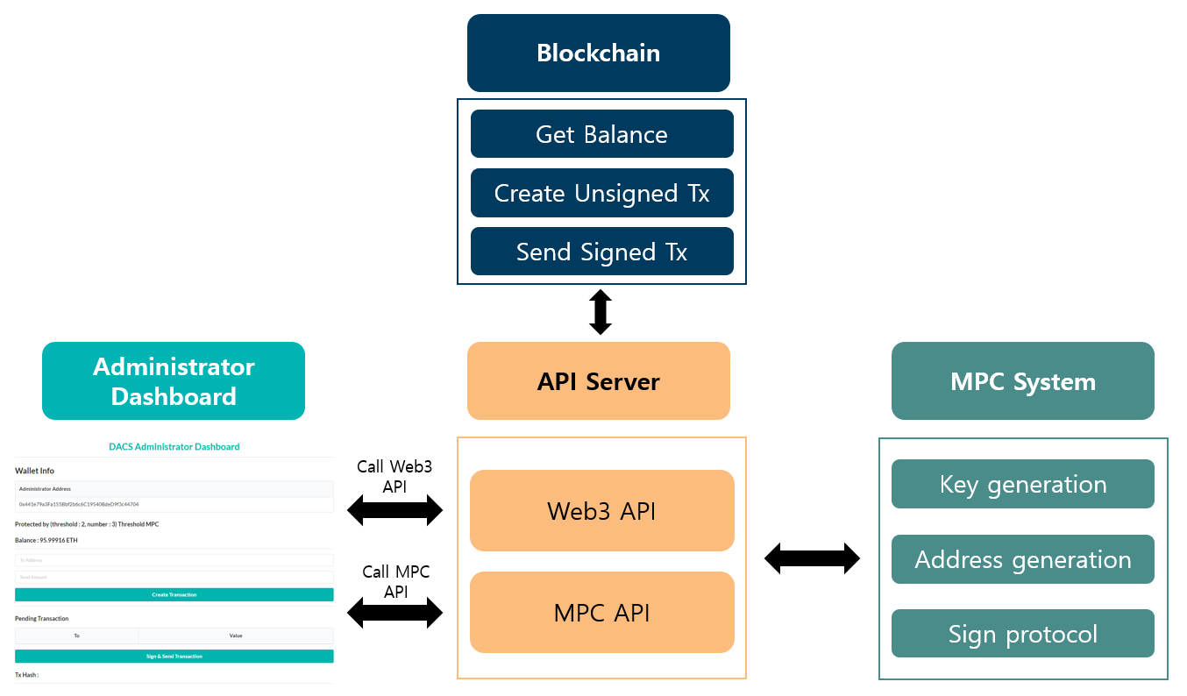
MPC
Overall Implementation

Slide 15
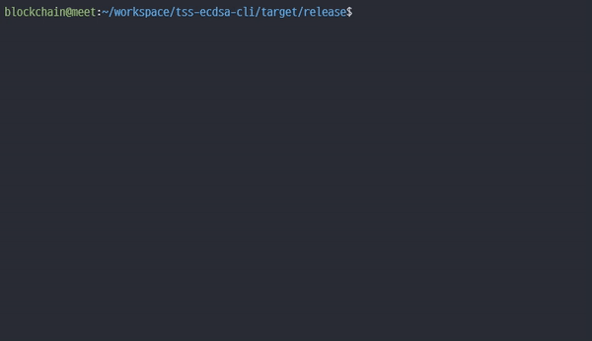
MPC - Key Management System (KMS)
Key Generation Protocol
Generate Key by
“Threshold {t-n} ECDSA”
--------------- Complete Key Gen ---------------
Signing Protocol
# sign > threshold
: signing protocol create the ECDSA signature (r, s, v).
Command : ./demo.sh <#threshold> <#party>
<#threshold+1> <unsignedTx>

Slide 16
MPC - Key Management System (KMS)
Address Generation Protocol
Generate Ethereum Address from the public key.
It makes “No one private key” but it can send or receive the Ether.
Key Generation Protocol
Address Generation Protocol
Shared Private Keys
Public Key (x,y)
Ethereum Address
Keccak-256(Ethereum Public Key) [:20]
Shared Private Keys
Shared Private Keys
Shared Private Keys
Public Key (x,y)
Ethereum Public Key
“04” | x | y

Slide 17
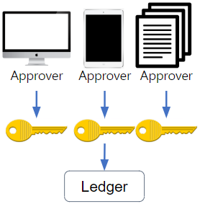
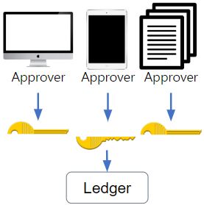
Summary
Multi-Signature (MultiSig)
✓ Customers can conveniently use their
digital assets
✓ Customers won’t lose money even if
their key is lost.
Multi-Party Computation (MPC)
✓ Virtual asset providers can safely store
entrusted digital assets by securely
storing private keys.

Slide 18
Future Work
Proceed detailed design including a Hardware Security Module (HSM)
physically safely store a piece of a private key
Evaluate and compare quantitative performance with the existing custody service

Slide 19
Finish

